Slide 1

EXTENDING CPN WITH RELATIONAL DATABASES
Master Thesis Defense
October 13
Aman Sinha
EMCL, UNIBZ, Italy

Slide 2

MOTIVATION

Slide 3


MOTIVATION
Data and Processes are integral part of a business.
Survey by Forrester [Karel et al, 2009]:
The Business Process Management (BPM) experts think that the data is subsidiary to the processes.
The master data experts think that the data are the main driver of the company existence.

Slide 4
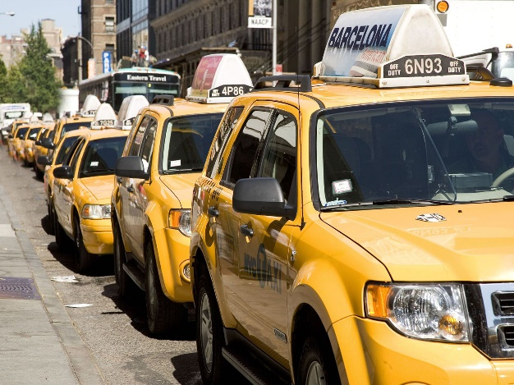


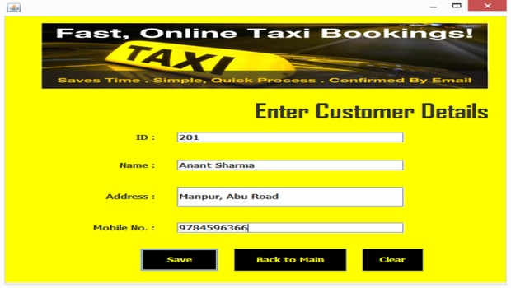
TAXI BOOKING EXAMPLE

Slide 5
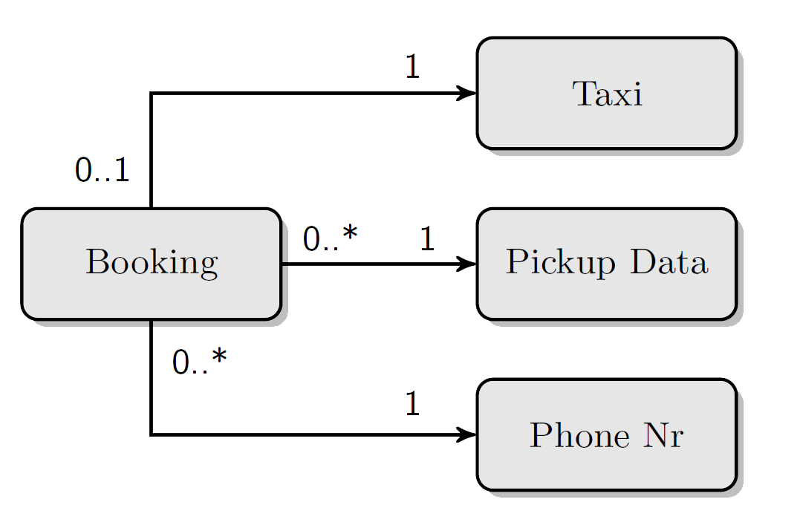
DATA MODELLING
Focus on : Relevant entity, relationship, constraints
Question:
The data component is static and how would the data evolve throughout the system. E.g. The evolution of the state of a taxi.
Notes:
Data Modeler would instantiate the Booking class first

Slide 6
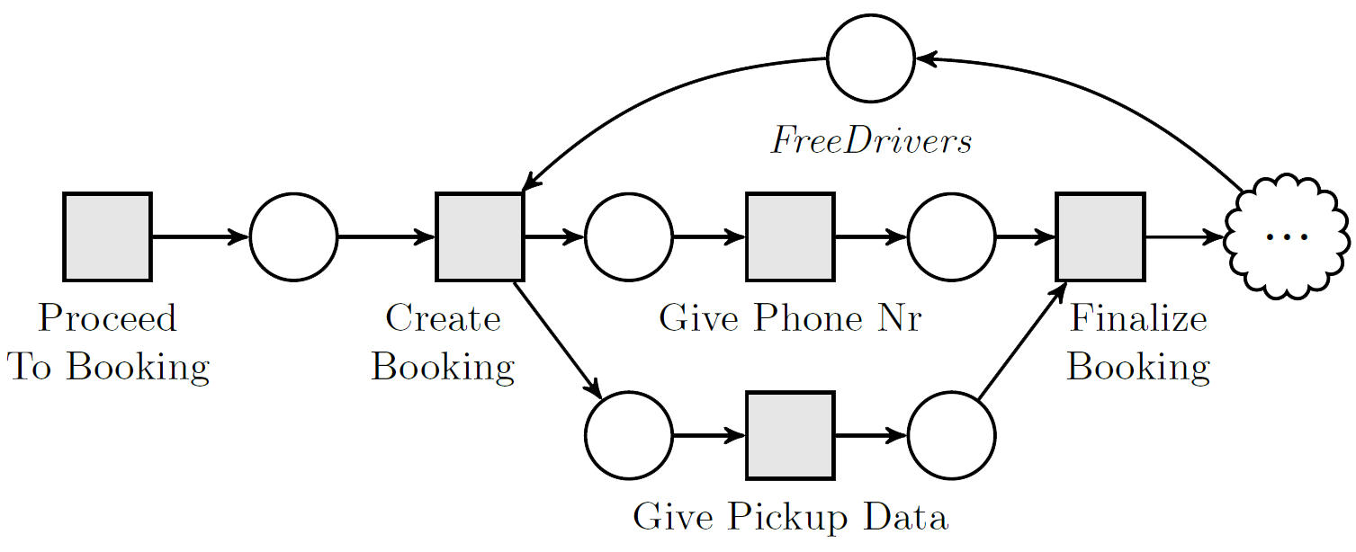
PROCESS MODELLING
Focus on : the workflow
Questions:
But how do the activities affect the data?
What if the Taxi which is just booked was busy?

Slide 7

DATA - PROCESS INTEGRATION

Slide 8

For understanding complex dynamic
systems, the marriage between
data and processes is necessary.
Notes:
Maintaince, evoluation and redundacy

Slide 9

STATE OF THE ART

Slide 10
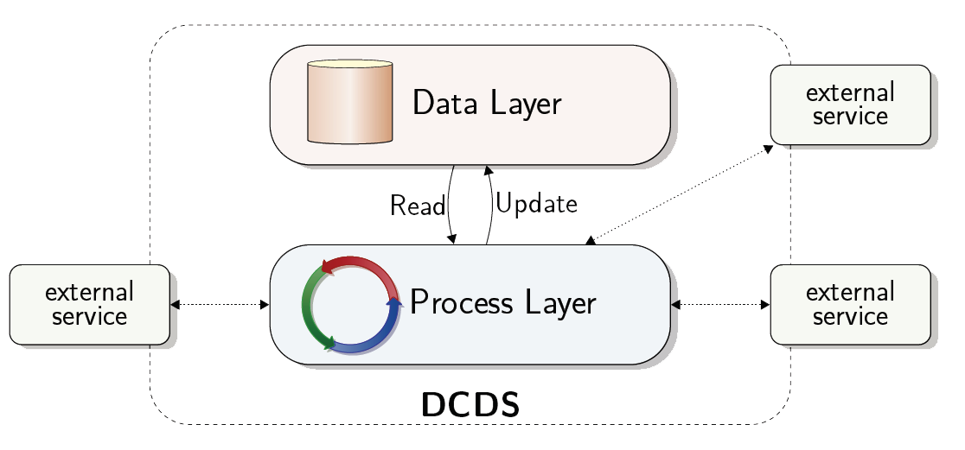
Data-Centric Dynamic Systems (DCDS)
Data Layer: relational DB with constraints.
Process Layer: evolves an instance of DB.
Condition-action rules: action execution, provide parameters.
Conditional CRUD operations with external inputs.

Slide 11
COLORED PETRI NETS (CPNs)
Petri Nets is a reference formalism used to model control flow and concurrency.
contains black tokens.
CPN is an extension of Petri net.
Token carry data along with themselves.
The tokens can be manipulated through the net through a well defined semantics.
Also used to formally model Business Process Models (BPM).
CPN Tools – most popular tool for modelling CPNs.
Notes:
Petri net reference formalism for control flow and concurrency, standard PNs no data, CPNs – tokens carry data, how they are manipulated

Slide 12
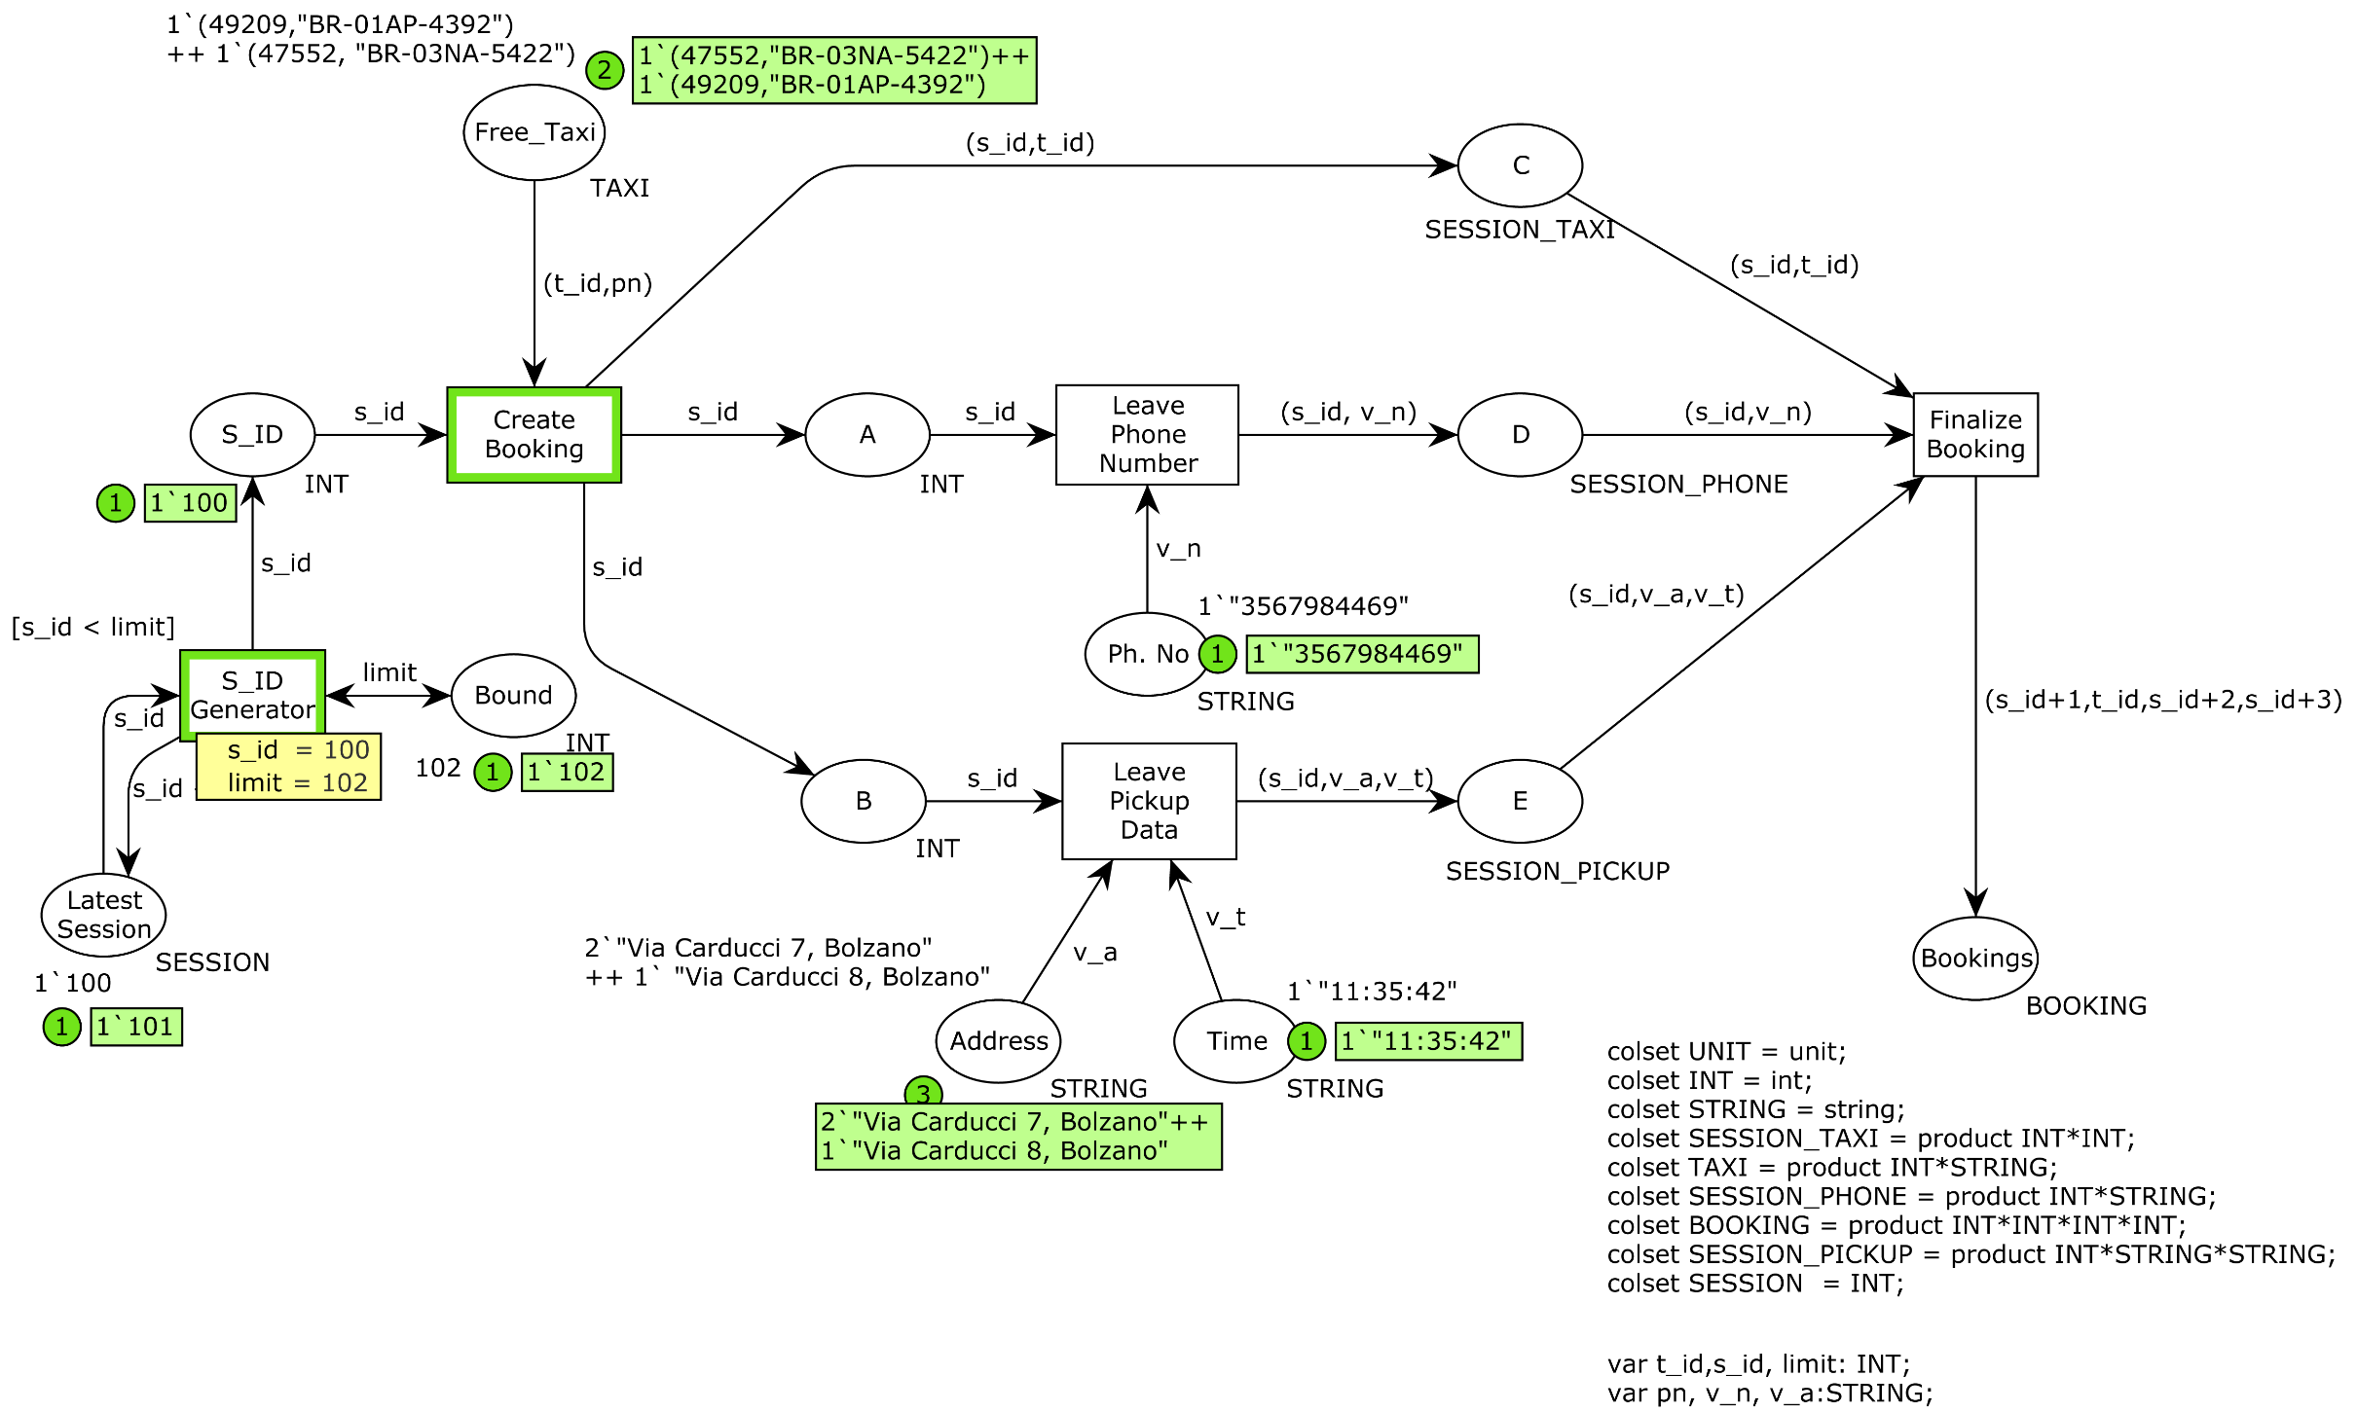
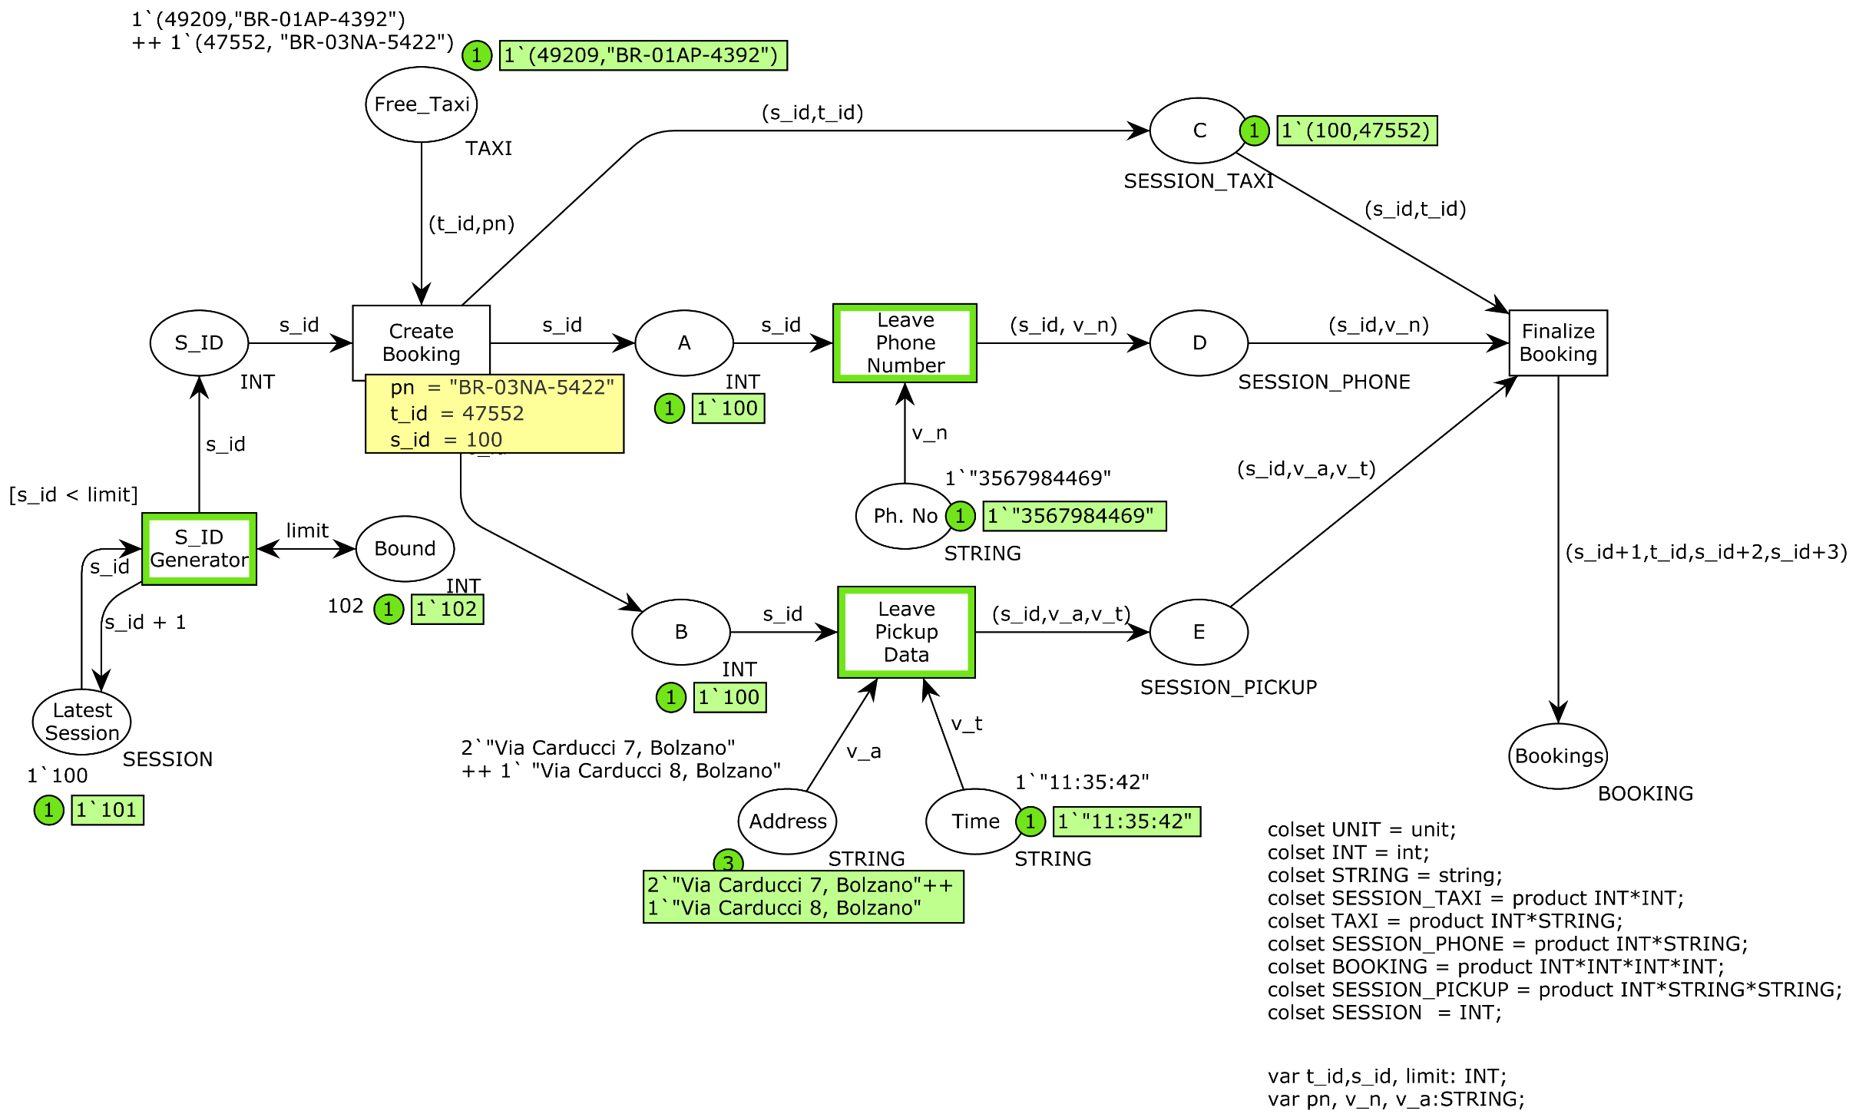
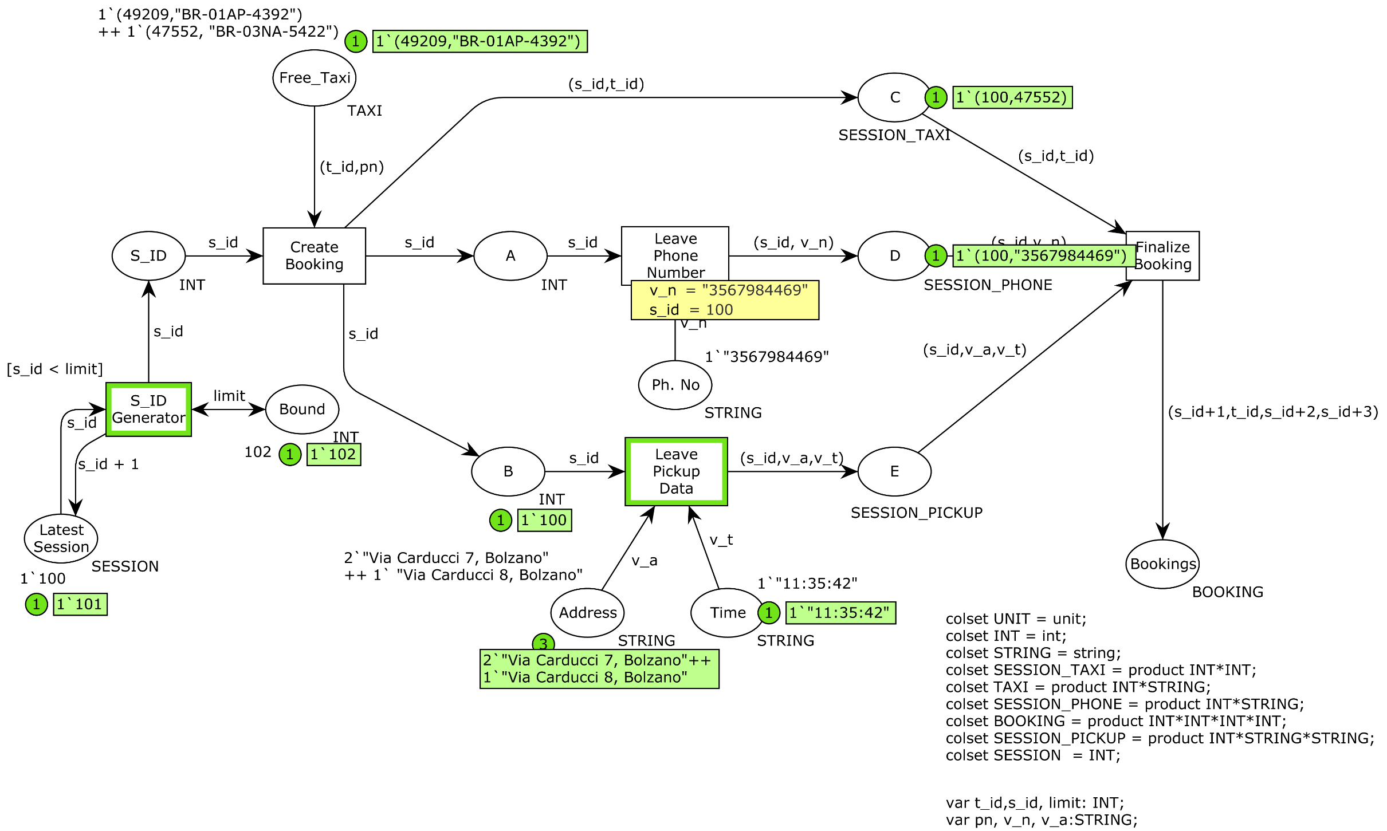
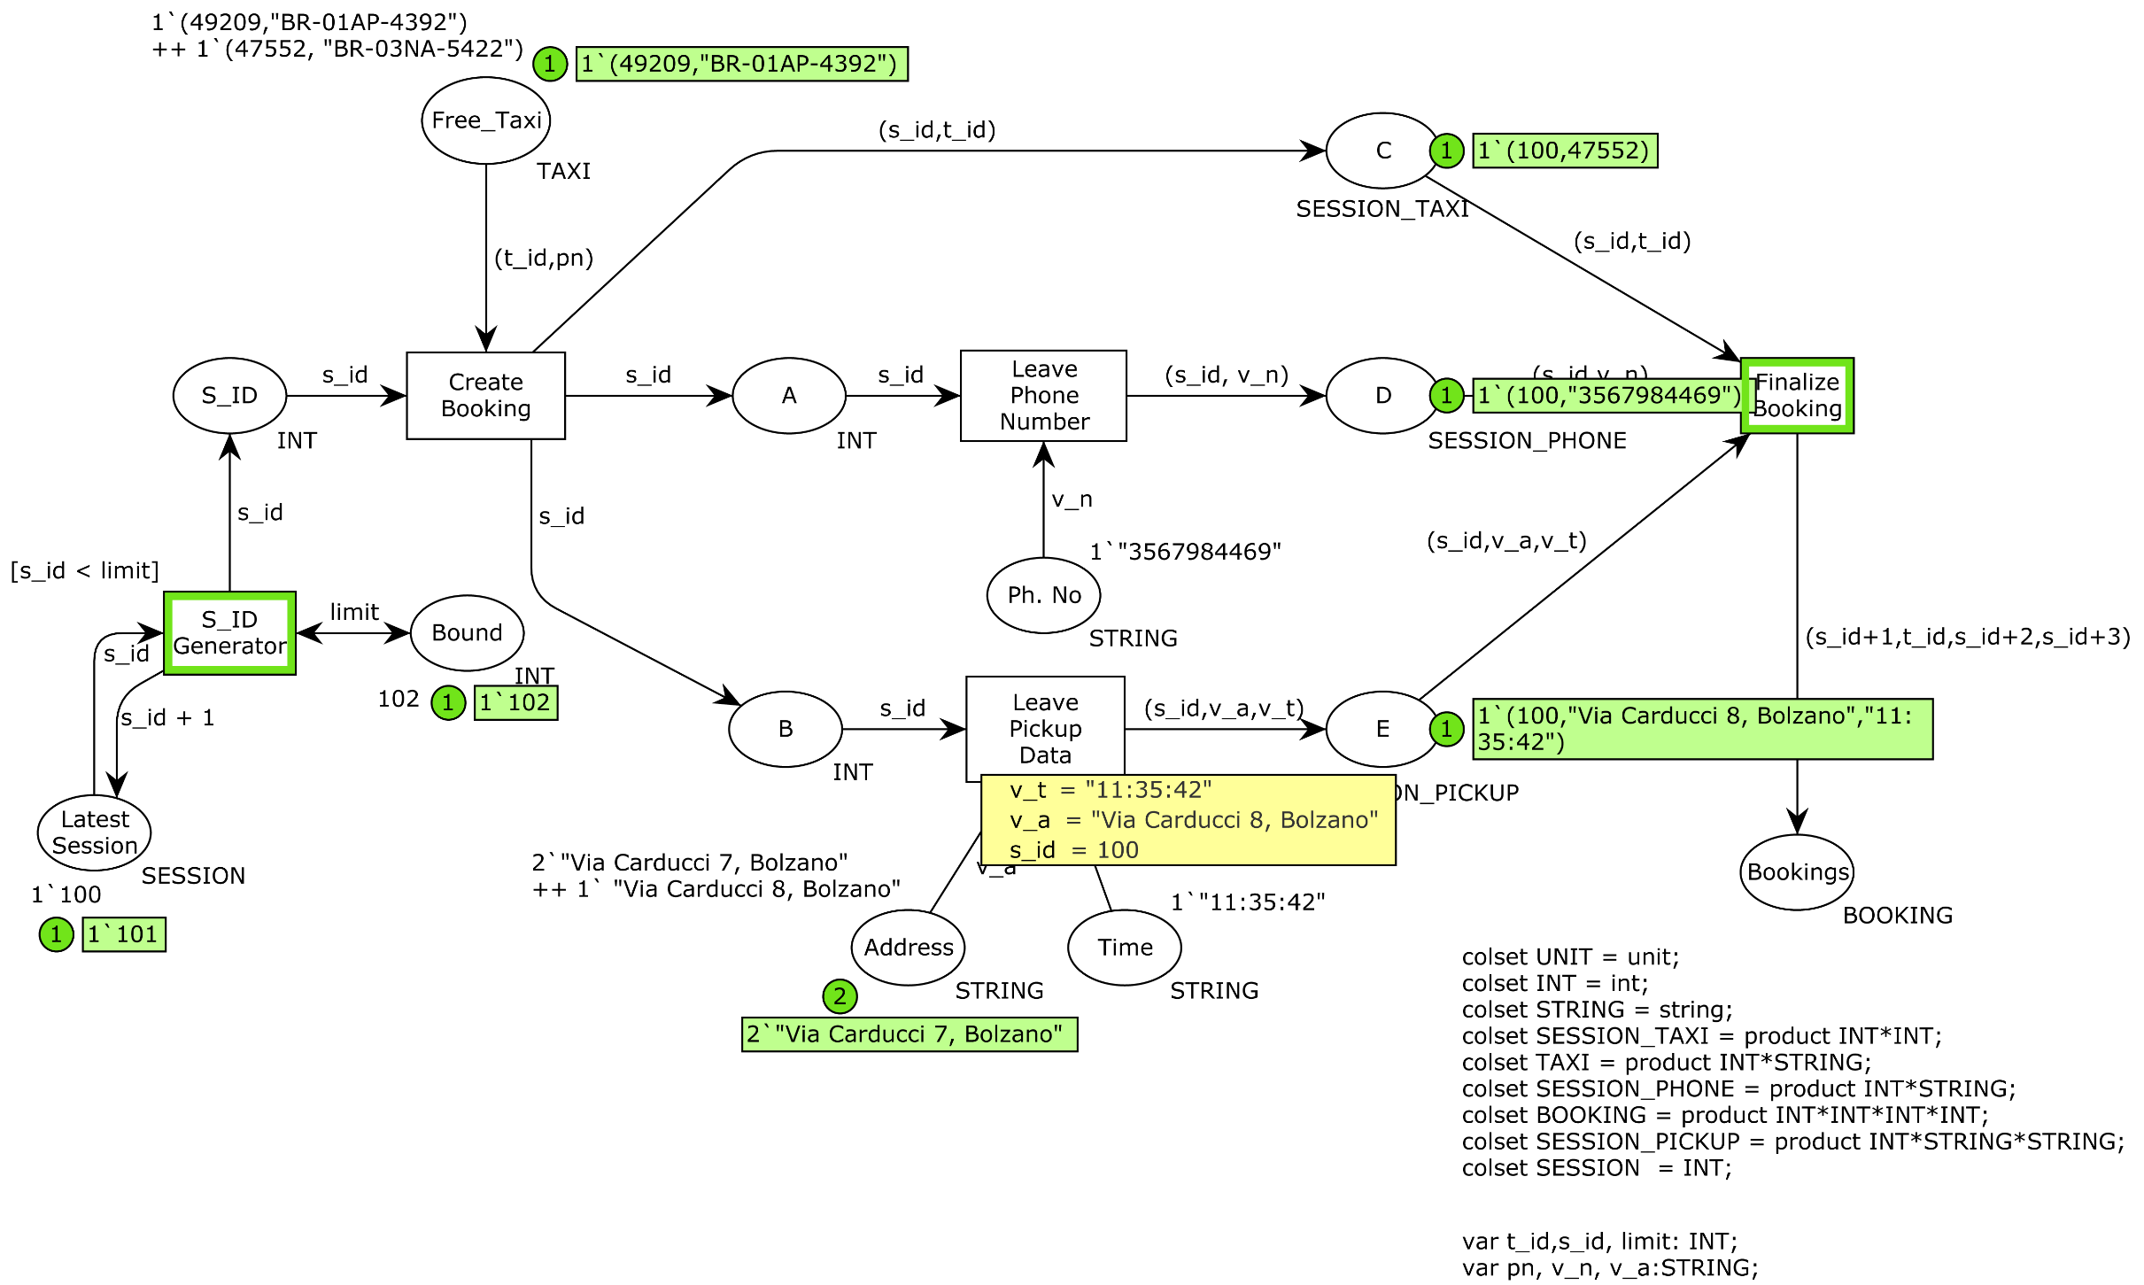
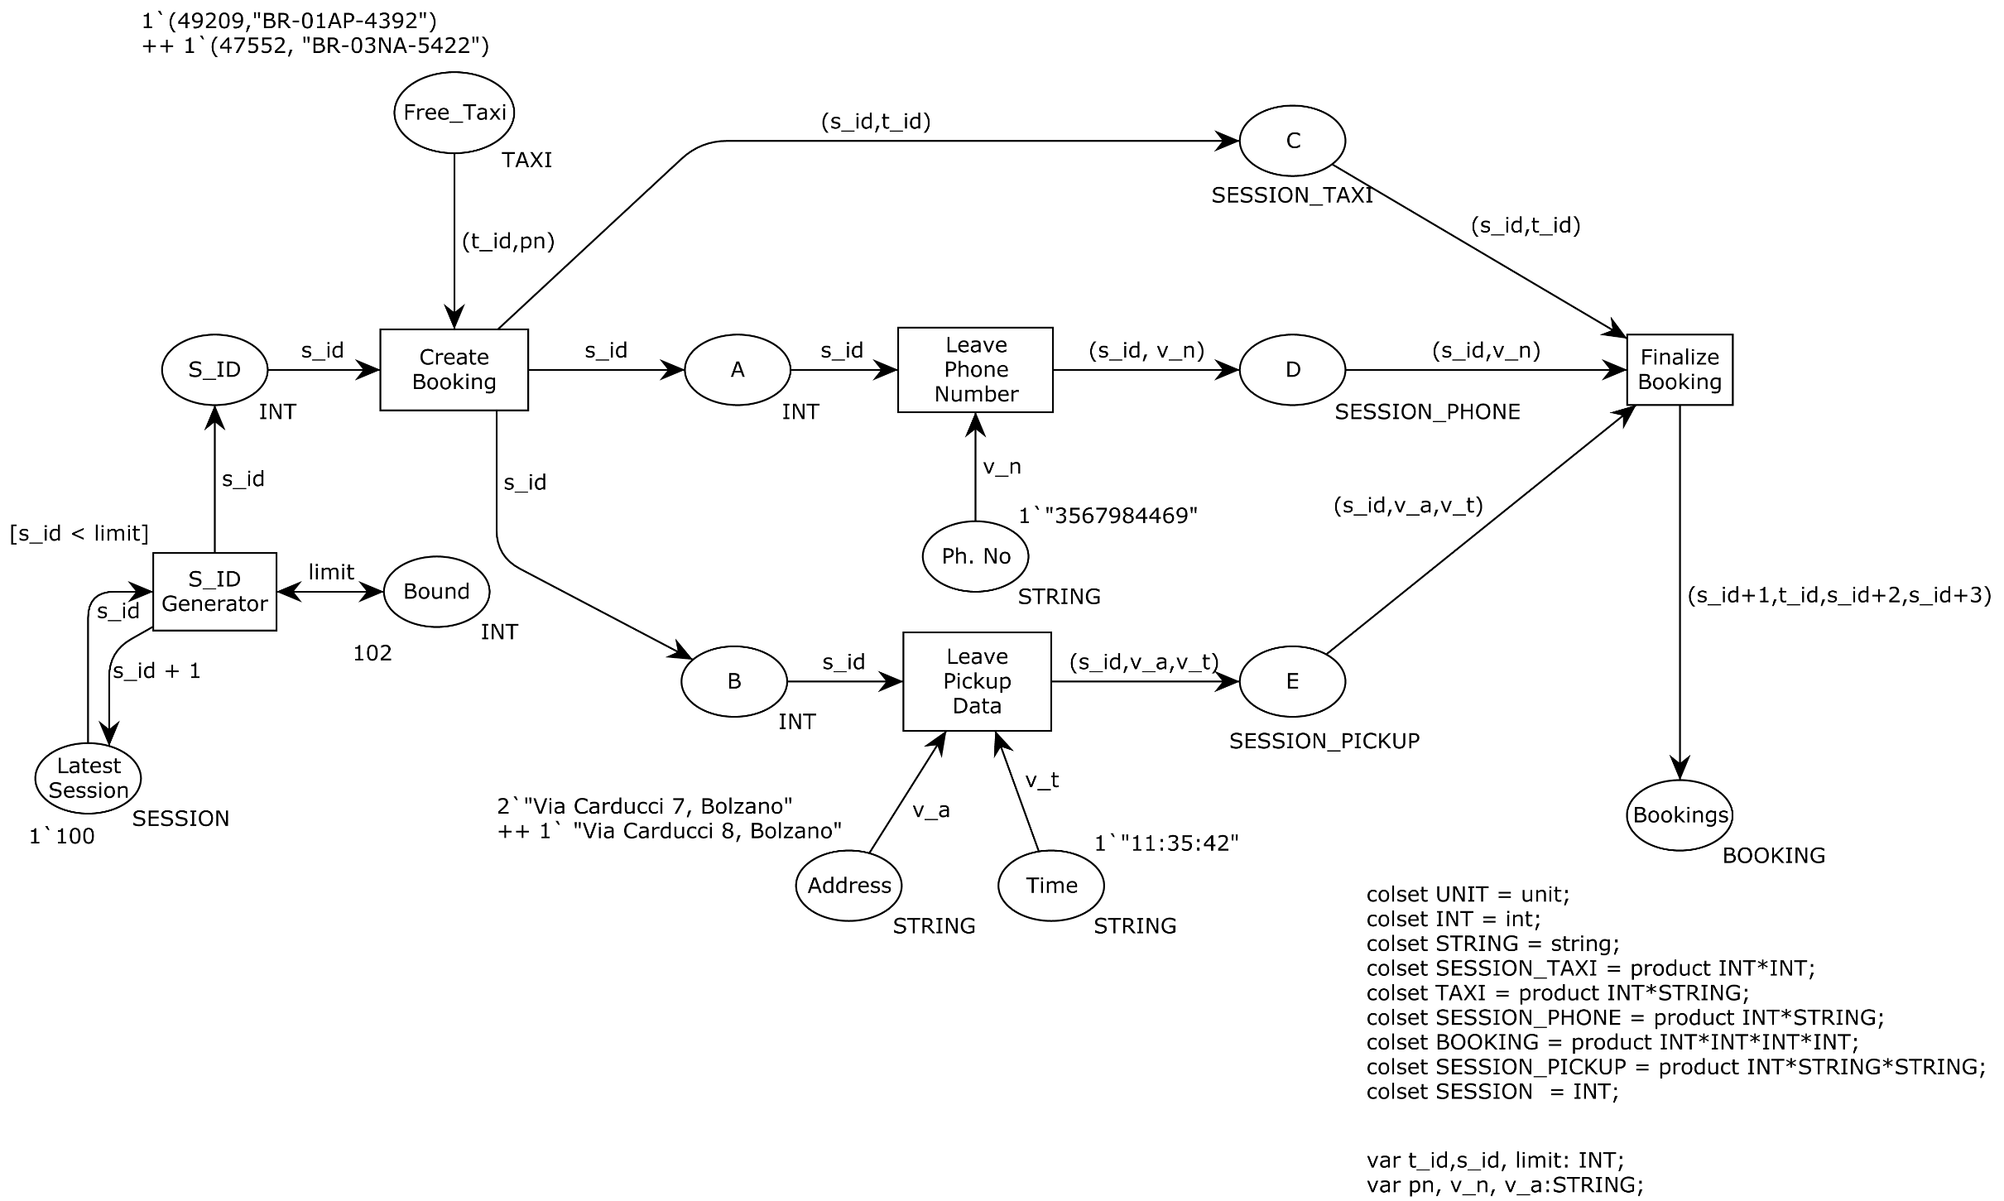
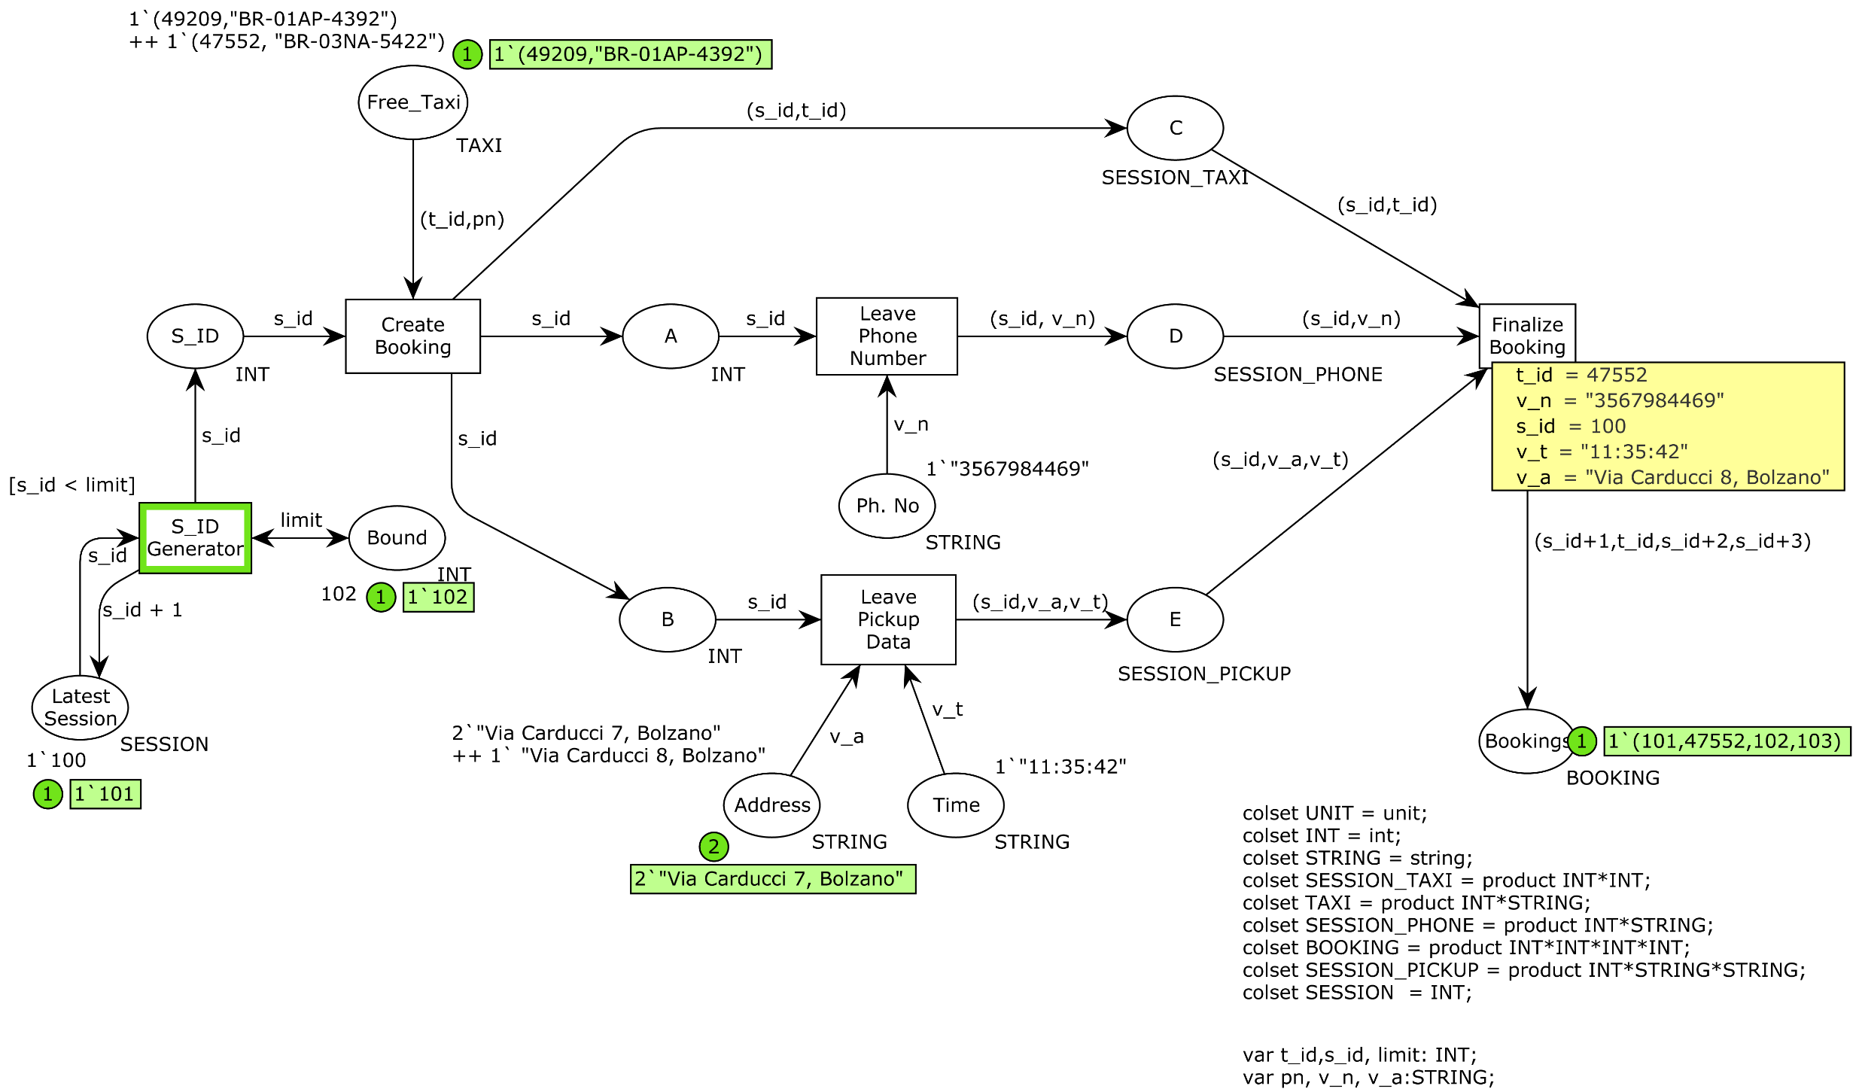
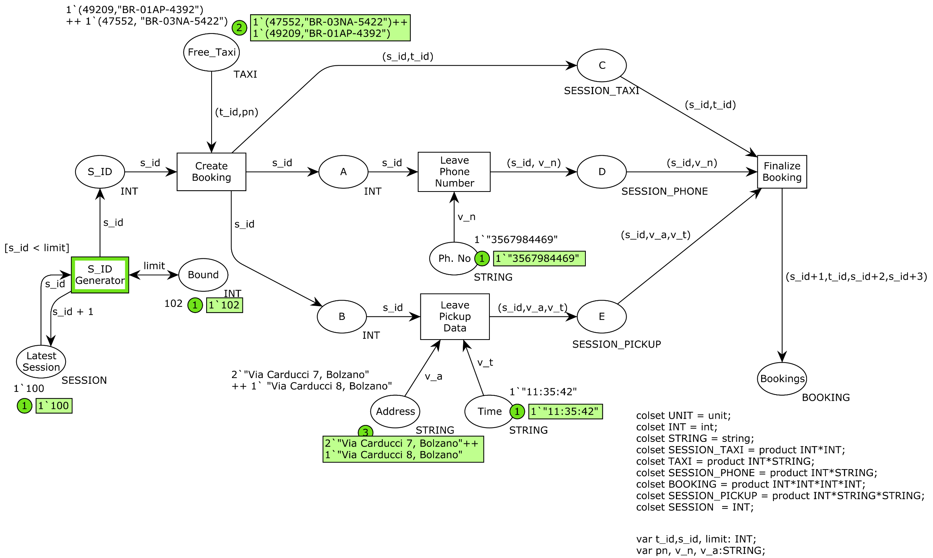
Initial Marking
Variables
Place Colours
Guard
Arc Expression
Colour Sets declaration
Variable declaration

Slide 13
STATE OF THE ART
Traditional models: focus either on data or on processes
Tools (Bizagi BPM, Bonita BPM, YAWL): handle the linkage between data and processes but in an ad-ho way
Two main lines of research emerged to conceptually integrate data and processes
In data centric approaches, e.g. DCDS
Supports CRUD operations on persistent data.
Lacks explicit control-flow and local (case) data.
In process centric approaches, e.g. CPN
Supports explicit control-flow and local (case) data.
Lacks support for CRUD operations on persistent data

Slide 14

MARRIAGE : CPN & DB

Slide 15
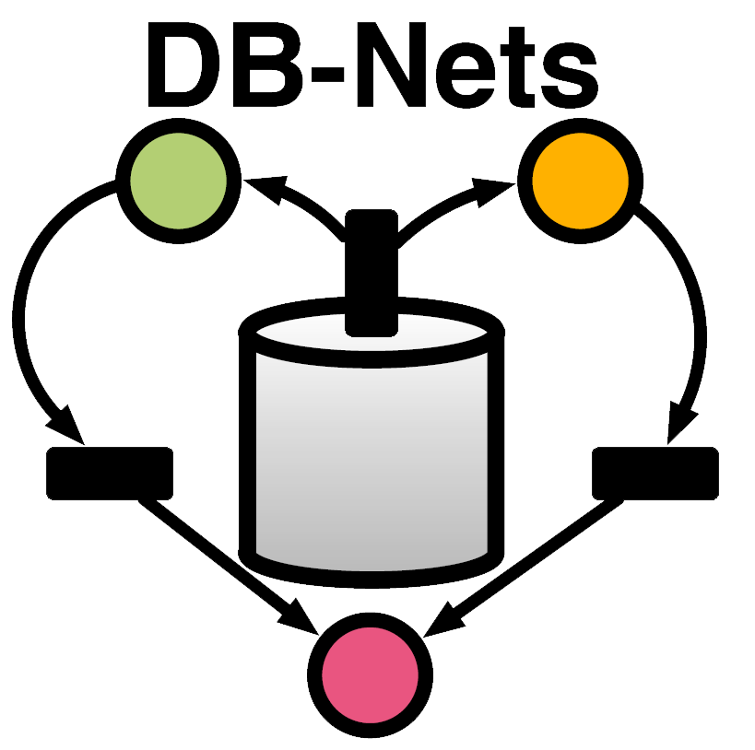

Slide 16
DB-NETS
Relational Extension of CPNs.
An attempt to integrate master data and business processes.
The persistent data is connected directly with the CPNs.
The data can be changed by invoking actions from the control layer
Three layered architecture
Persistence Layer
database
Data Logic Layer
bidirectional interface between control layer and persistence layer
Control Layer
CPN model enriched with data logic elements

Slide 17
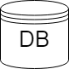
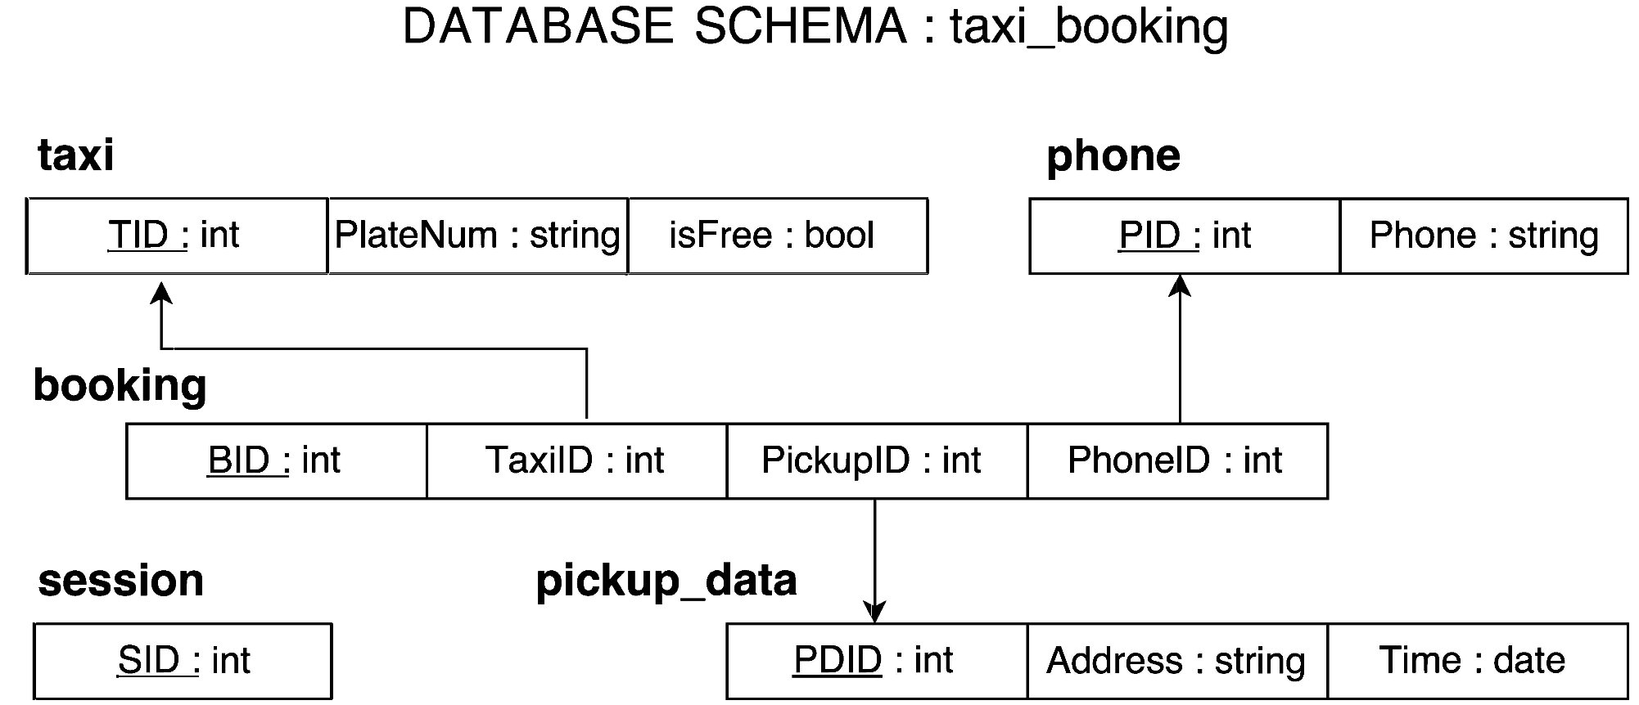
PERSISTENCE LAYER
Full-fledged relational data base (with constraints).

Slide 18
DATA LOGIC LAYER
Bidirectional interface between persistence layer and control layer.
Processes queries issued by the control layer and returns the answers from the DB.
Receives parameters from the control layer to instantiate the actions which performs updates (add – delete list) over the persistence layer.

Slide 19
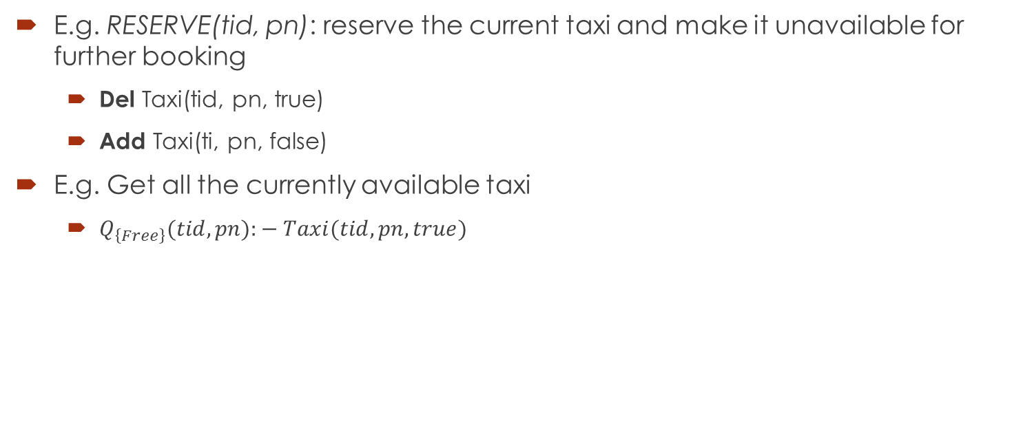
EXAMPLE
E.g. RESERVE(tid, pn): reserve the current taxi and make it unavailable for further booking
Del Taxi(tid, pn, true)
Add Taxi(ti, pn, false)
E.g. Get all the currently available taxi
$Q_{\left\{Free\right\}}(tid,pn):− Taxi(tid,pn,true)$

Slide 20
CONTROL LAYER
It is a coloured Petri net “extended” with
view places
action transitions
read arcs
Models CRUD operations over the persistence layer.

Slide 21

CONTROL LAYER – VIEW PLACE
Represents the snapshot of the database instance.
Carries a query and the answer to the query must be compatible to the colour set of the view place.
Connected only by read arcs which doesn’t allow consumption of tokens from the view place.
Automatically updated when a transition in the control layer is fired.
Free Drivers
$Q_{\left\{Free\right\}}(tid,pn):− Taxi(tid,pn,true)$
int X string

Slide 22
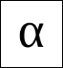
CONTROL LAYER – ACTION TRANSITION
Using an extra transition-labeling function we assigns an action to transitions
Helps in performing actions over the persistence layer.
Responsible for acquiring data from the environment using fresh variables.
E.g. Create Booking transition – performs RESERVE action.
Create
Booking
RESERVE
(tid,pn)

Slide 23
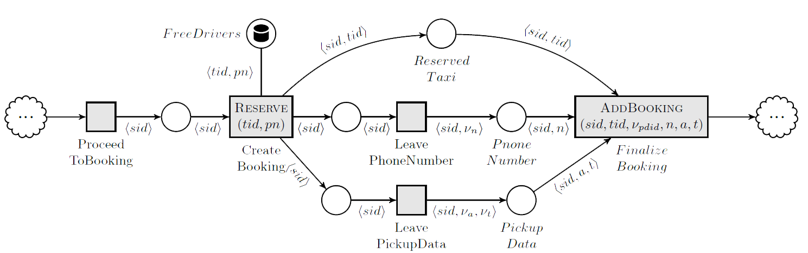
DB-NETS EXAMPLE

Slide 24

OBJECTIVE
To develop a CPN Tools extension which is responsible for modelling, simulation, execution and analysis of DB-nets.

Slide 25
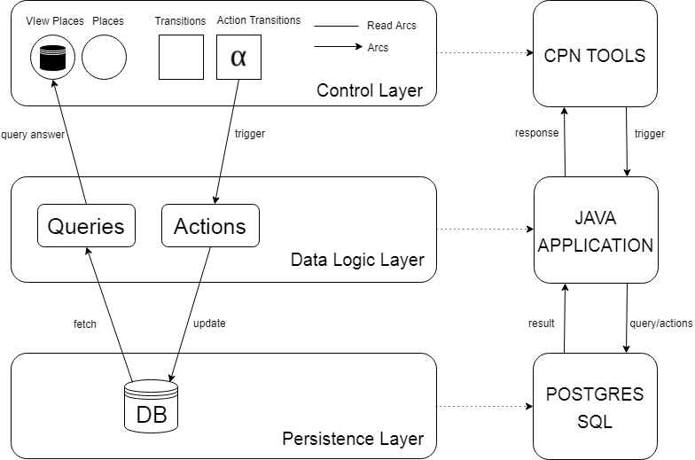
DB-NETS

Slide 26
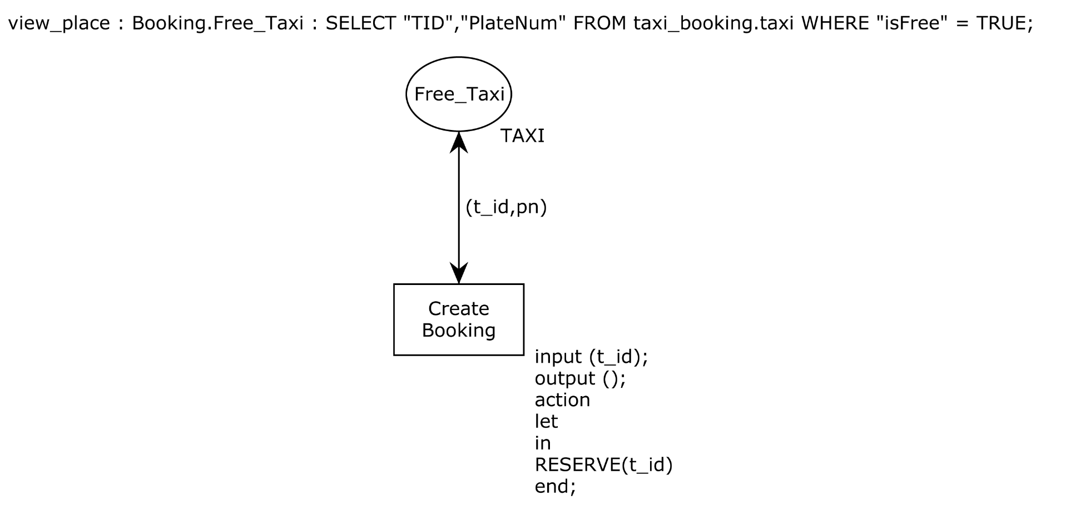
VIEW PLACE AND ACTION TRANSITIONS
query
read arc
action
Notes:
anchors

Slide 27
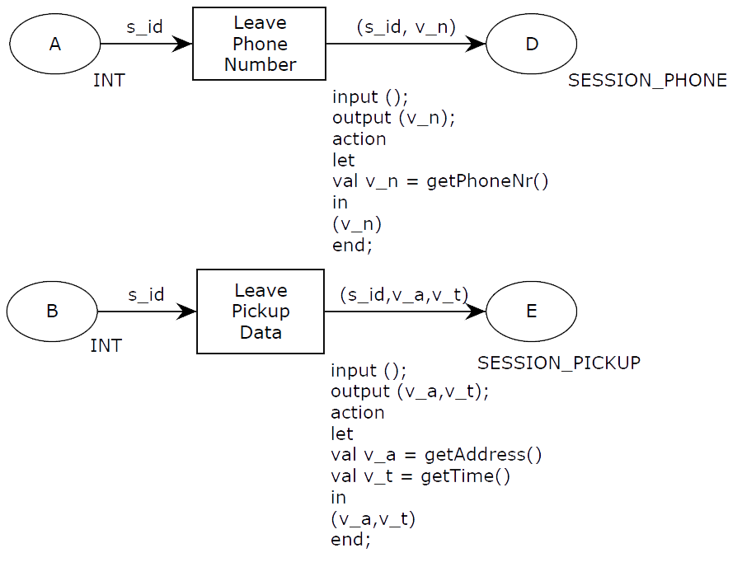
DATA ACQUISITION
fresh variable
data acquisition

Slide 28
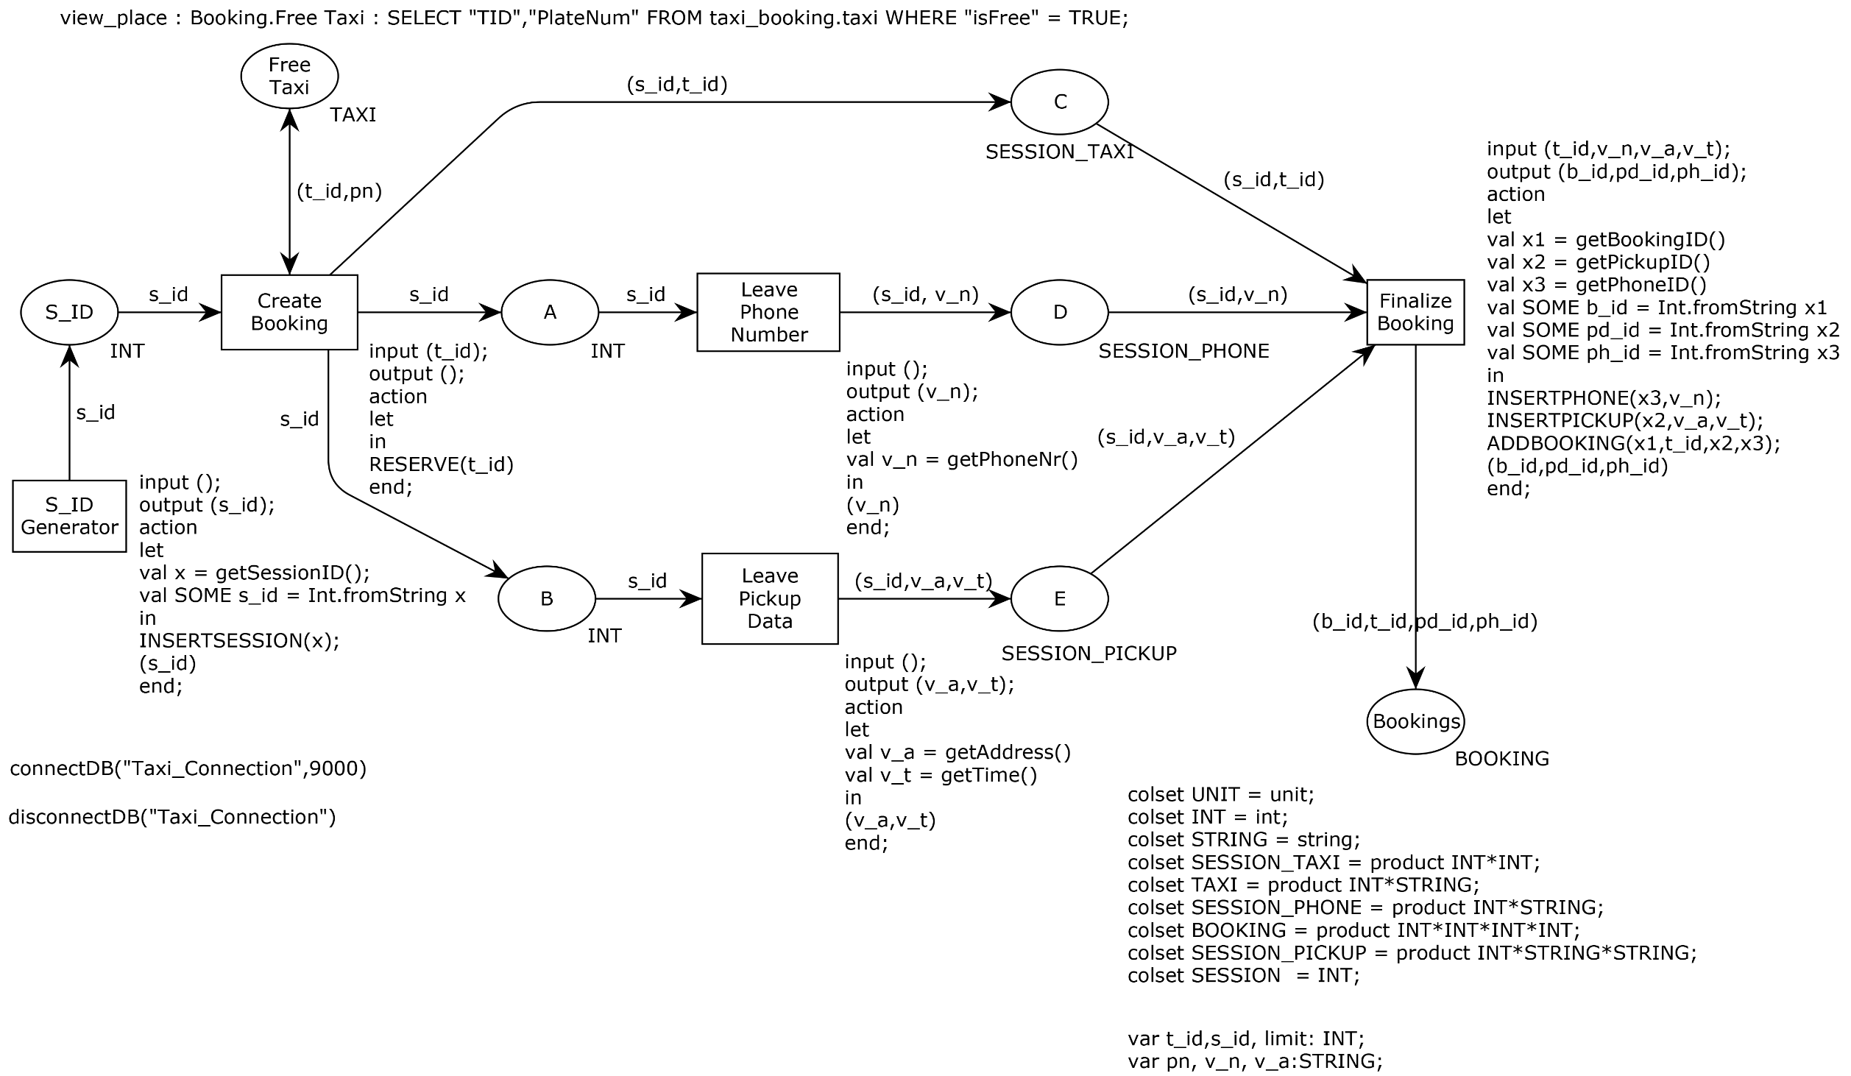

Slide 29


Slide 30


Slide 31
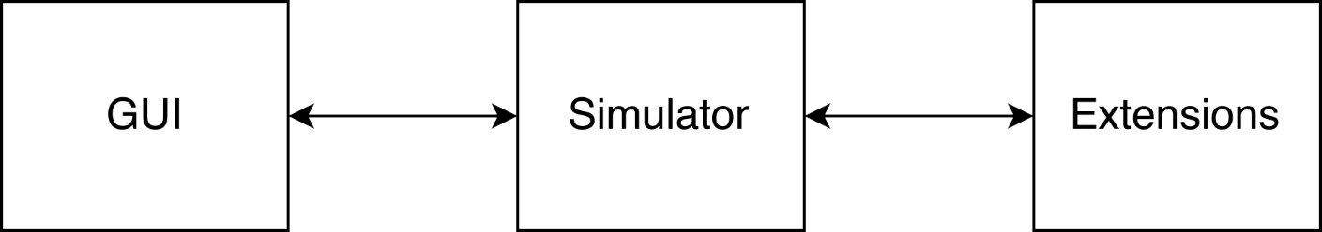
CPN TOOLS EXTENSION
CPN Tools version 4 supports development of extensions using Access/CPN.
Access/CPN – a framework to facilitate development of extensions.

Slide 32
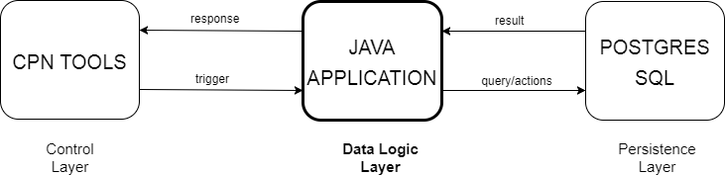



Slide 33
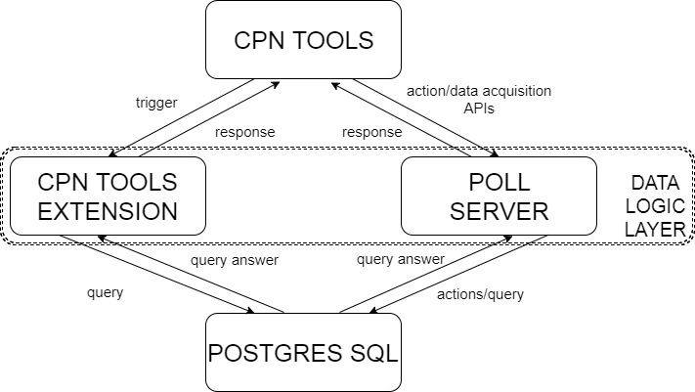
ARCHITECTURE

Slide 34

Developing extension is not so easy
Listen to events and take proper action.
For view places – more than 10 explicit calls between GUI, Simulator and Extension (excluding the DB calls).
Creating own packets to feed the CPN (populating view places).
For data acquisition and performing actions, a specified TCP/IP port to be used.
Messages passed in terms of stream of bytes.
Developing a parser to parse the intended actions, pass to query to the database and returns the result.

Slide 35
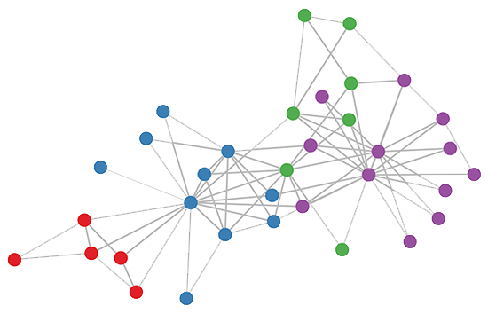
STATE SPACE ANALYSIS

Slide 36
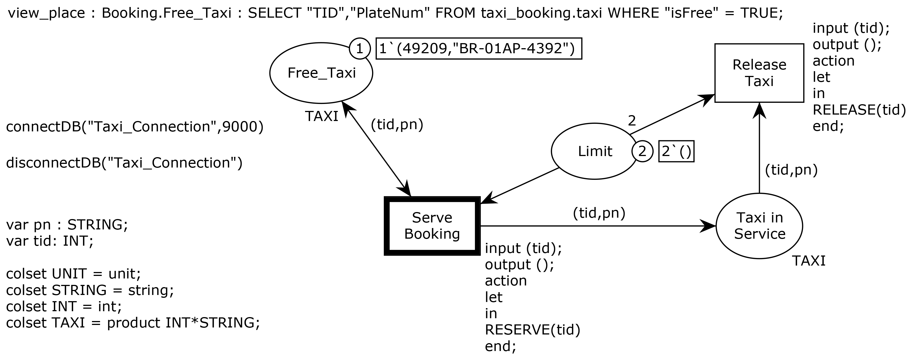
REDUCED TAXI BOOKING MODEL

Slide 37
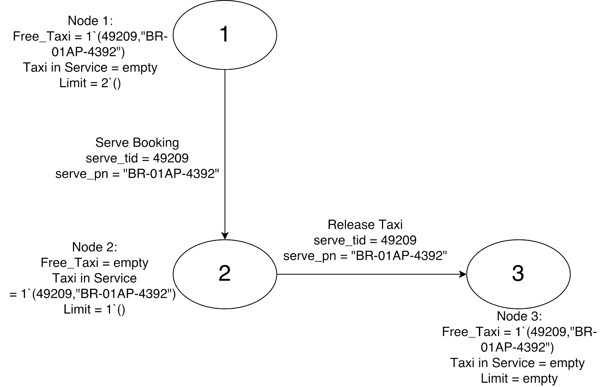
EXPECTED STATE SPACE

Slide 38
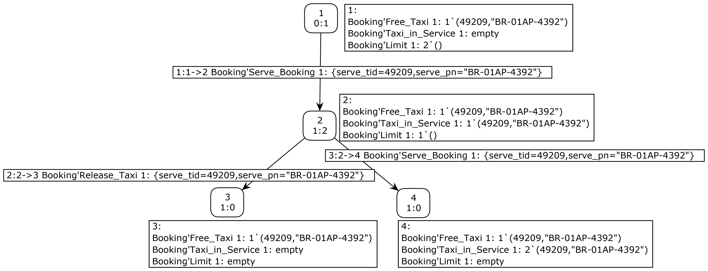
STATE SPACE BY CPN TOOLS
While generating nodes of the state space, view places could not be populated.

Slide 39

FAILED ATTEMPTS

Slide 40
INTERCEPTING STATE SPACE TOOL
Trying to intercept packets and change contents while drawing the state space.
Not a good idea to play with packets – might lead CPN Tools into an inconsistent state.
Even if we succeed with changing packets, the generated state space report is not correct.

Slide 41

SHARED ARCHITECTURE
Modify the architecture to explicitly update the view place.
Ends up in an infinite wait as the simulator lock, a lock to modify the control layer using simulator, is already acquired by the state space tool.

Slide 42

WORKAROUND

Slide 43
FROM DB-NETs TO CPNs
We compile DB-nets into CPNs by lifting databases to the control layer and representing data logic operations using normal CPN transitions.
Database relations are lifted into additional, relational places. Each tuple becomes a token.
View places are removed and the inspection of a view place is substituted by CPN arcs and inscriptions that reconstruct the query associated to the view place
Restriction:
views should contain conjunctive queries with filters.
we do not include the database constraints.
Actions are transformed into non-interruptible sequences of delete/add transitions directly modeled into the CPN itself.

Slide 44
ACTION TRANSITIONS
The actions attached to the transitions are reconstructed in CPN and modelled using sequential pipeline adhering to the semantics of DB nets.
Priority Transitions (to preserve set semantics):
Assigning high priority to a transition to force it to occur before all other enabled transitions.
Using priority transitions we serialize the execution of transitions.
E.g. for delete operation, if a token is present at relational place, execute delete, else execute no-op.

Slide 45
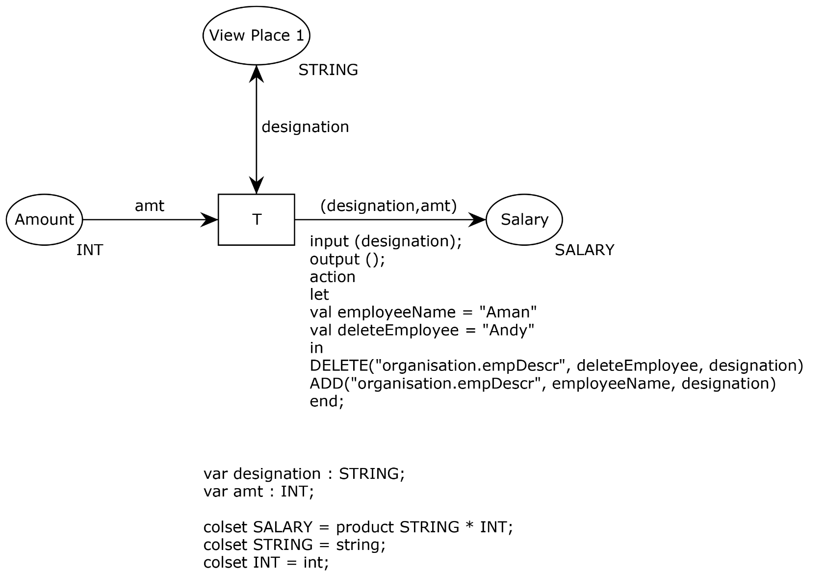
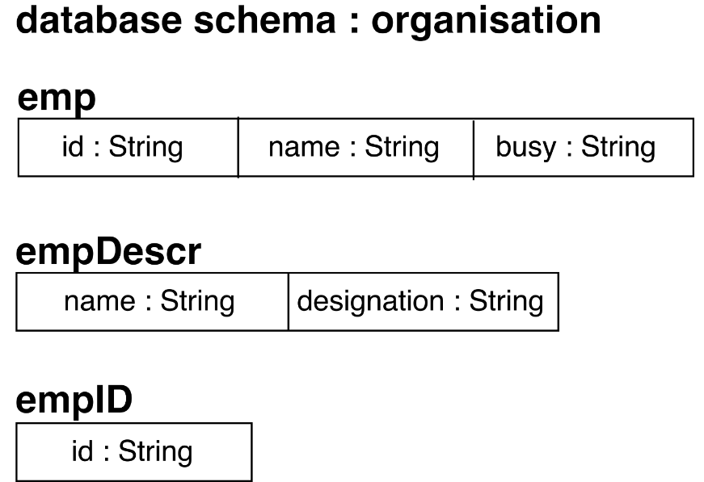
EXAMPLE
SELECT organisation.empDescr.designation FROM
organization. empDescr, organisation.emp WHERE
organisation.empDescr.name = organisation.emp.name;

Slide 46
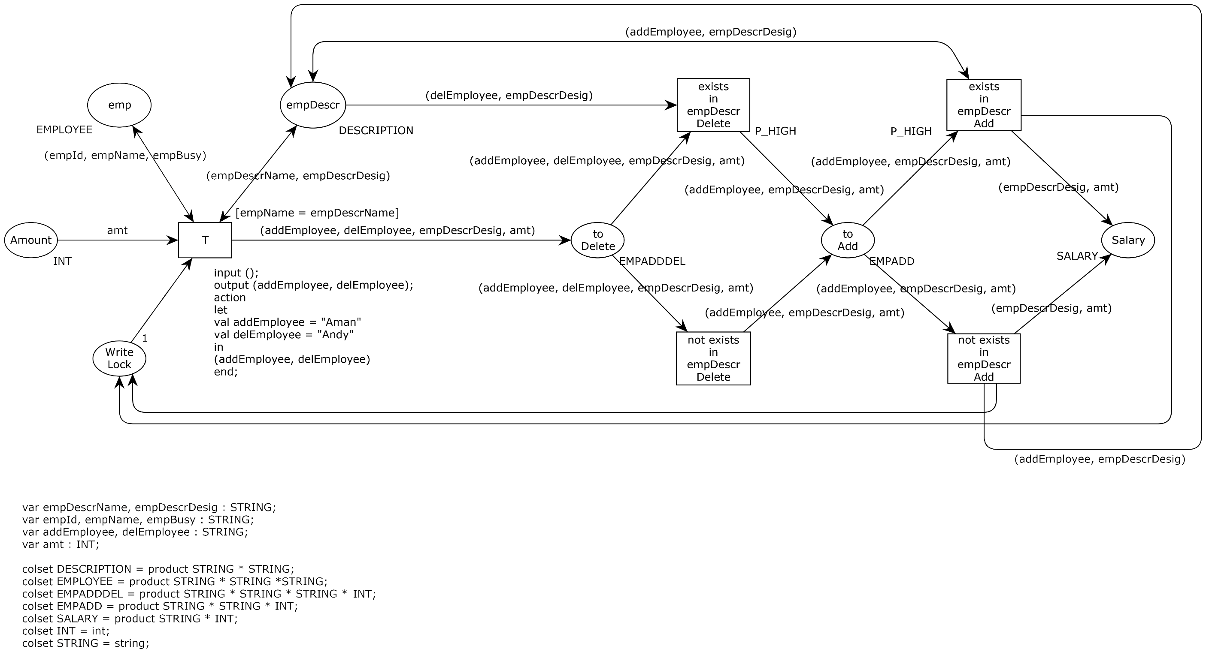
High priority
guard

Slide 47
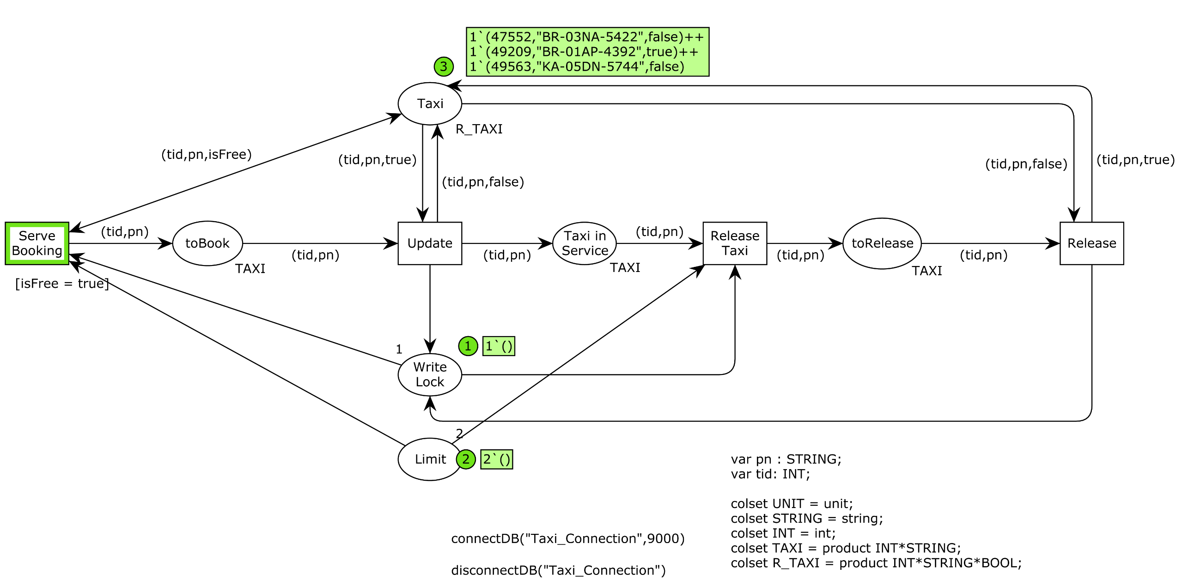

Slide 48
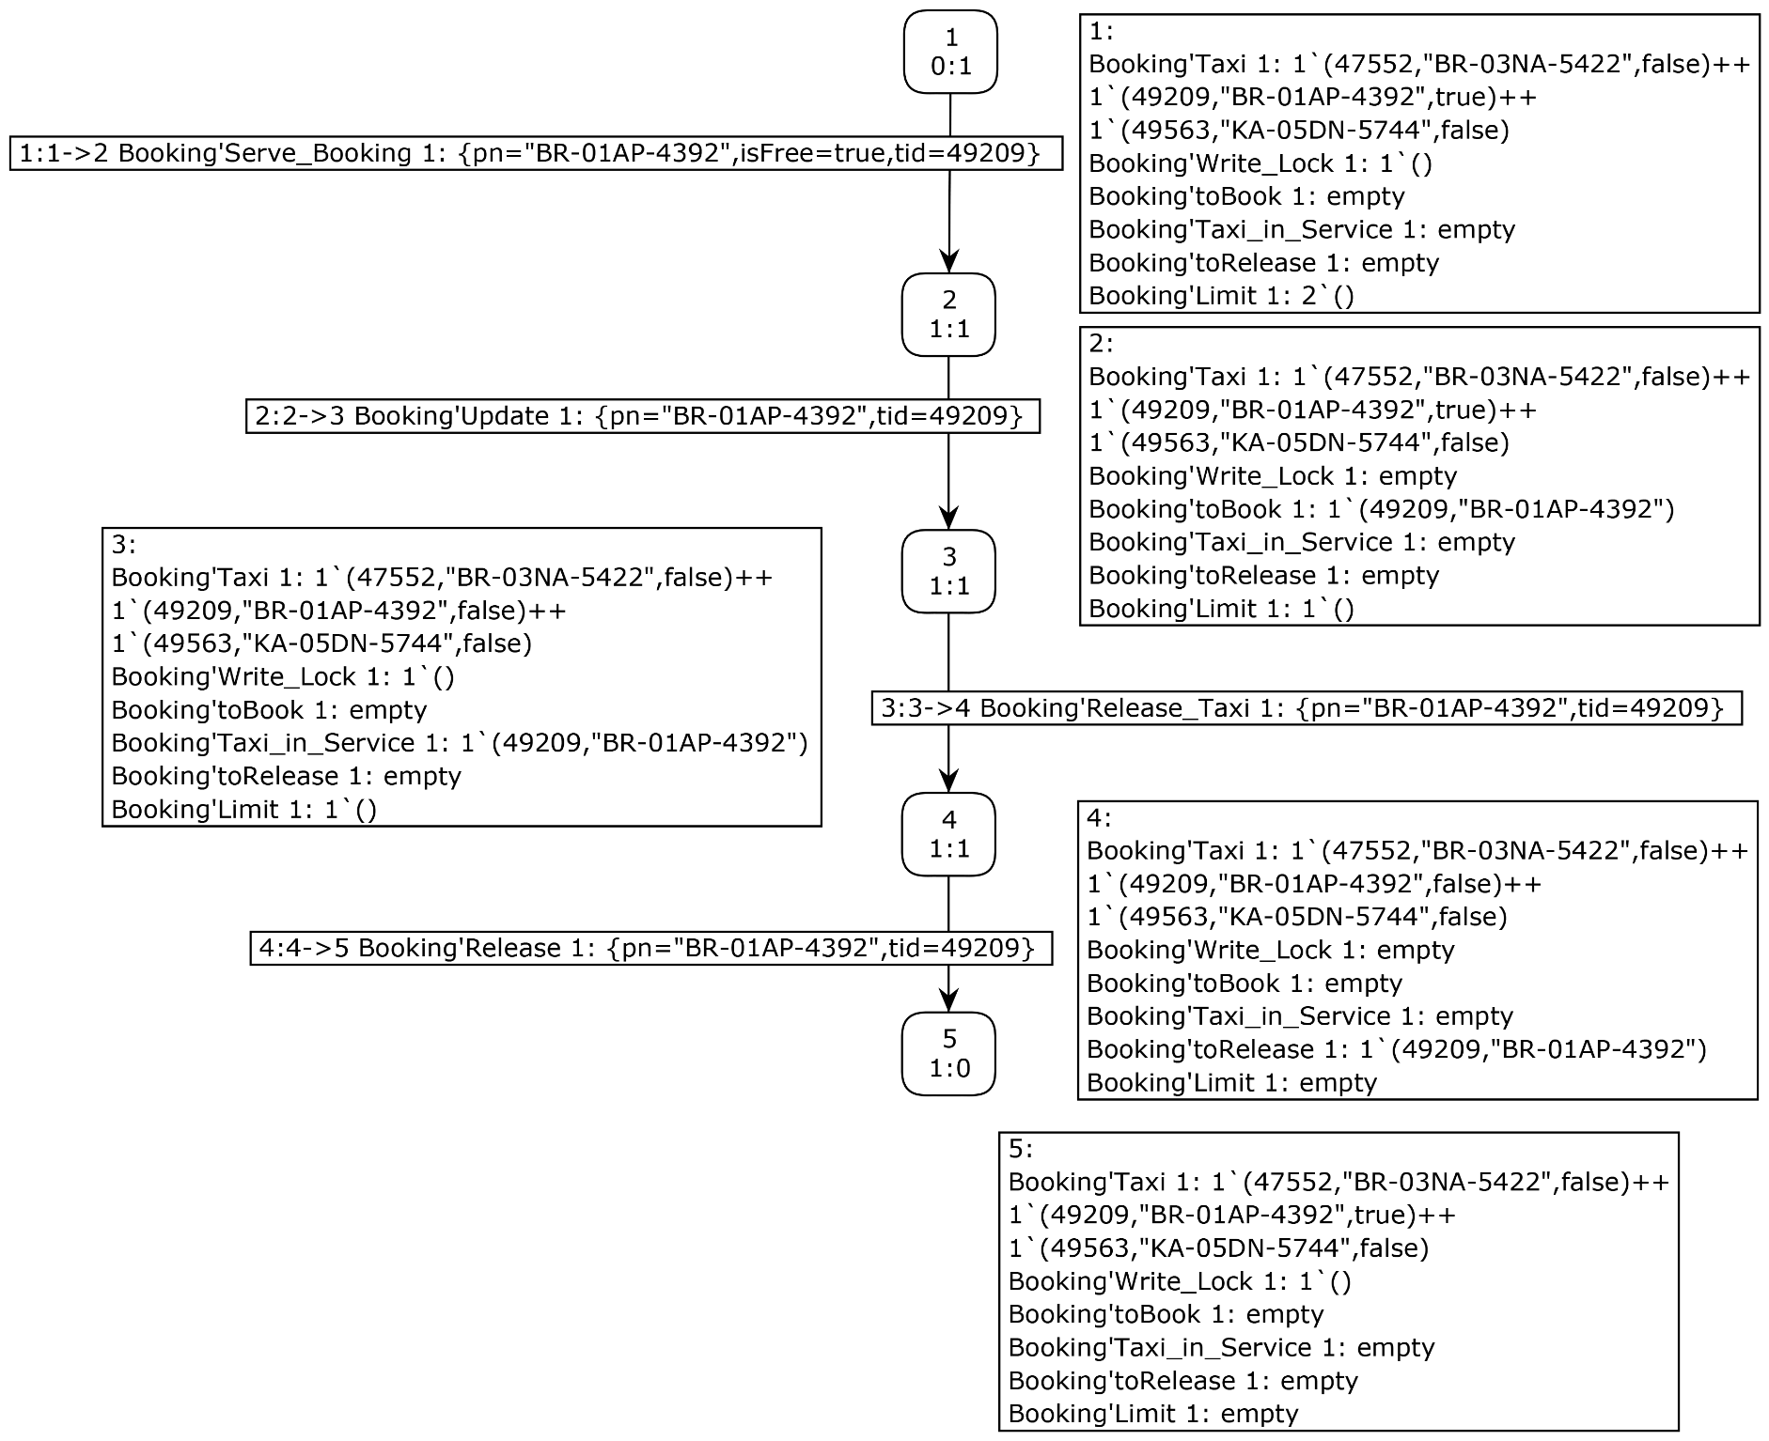

Slide 49

CONCLUSION

Slide 50
Created a CPN Tools extension which implements the functionality of DB-nets.
Using relational places and compilation mechanism, we are able to calculate the state spaces.
Ongoing work : Formalize the translation from DB-nets to CPNs and prove its correctness.
Future work: Empirical evaluation of DB-nets.
We encourage researchers to possibly find a cleaner solution for calculating state space.
The simulation of DB-nets can be particularly useful for creating benchmarks for data preparation to perform process mining.

Slide 51
THANK YOU!

Slide 52
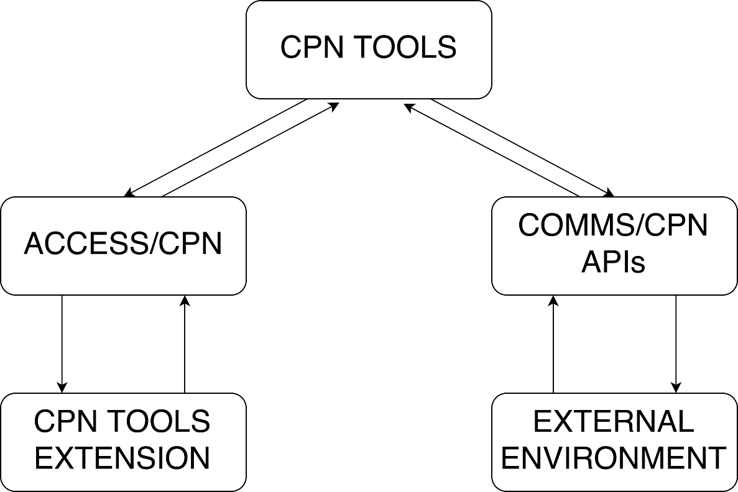
COMMS/CPN
A library written in SML to connect CPN Tools with external processes.
Notes:
May be remove the slide, and put them in the end

Slide 53
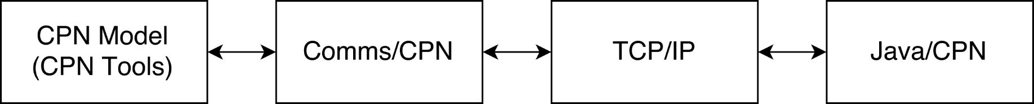
JAVA/CPN
A JAVA library to connect JAVA processes to CPN Tools.
Notes:
Put them in the end

Slide 54
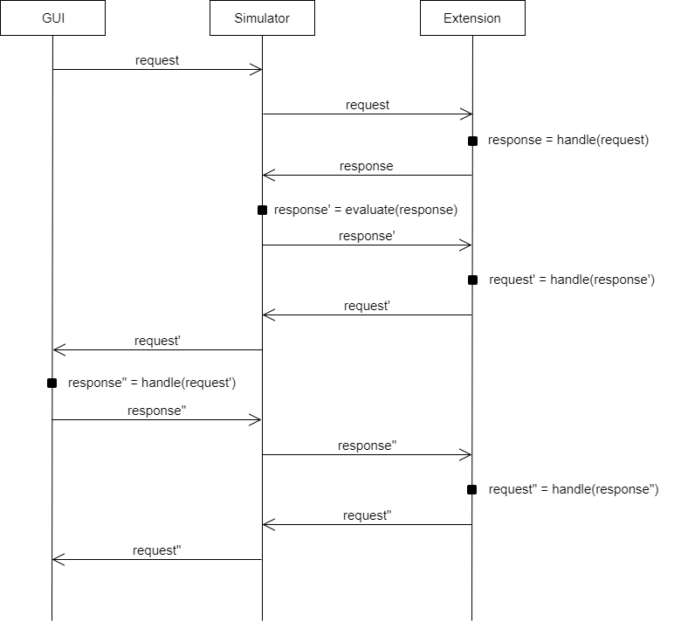
COMMUNICATION PATTERN
Notes:
After this critical elements to be implemented, put this slide in the end. Make a slide about the

Slide 55
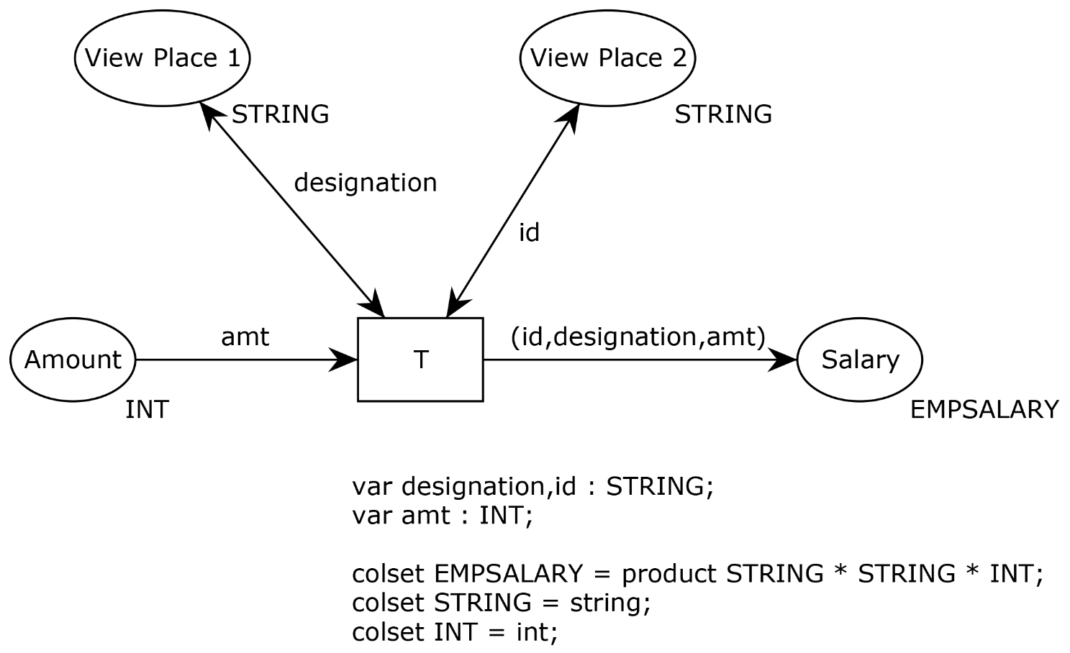
VIEW PLACE COMPUTATION
View Place 1:
SELECT organisation.empDescr.designation
FROM organization. empDescr,
organisation.emp WHERE
organisation.empDescr.name =
organisation.emp.name;
View Place 2:
SELECT organisation.empID.id
FROM organisation.empID,
organisation.emp WHERE
organisation.empID.id =
organisation.emp.id;

Slide 56
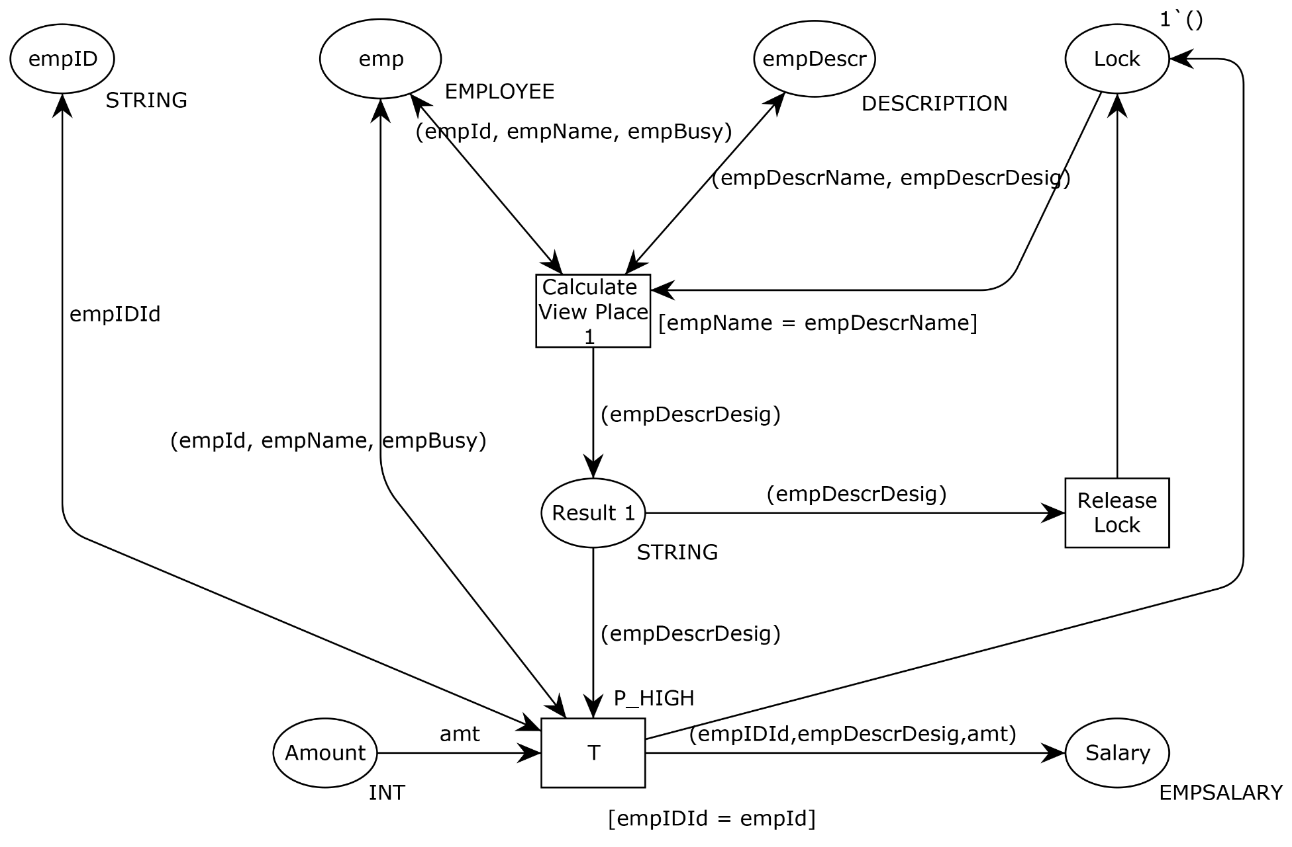
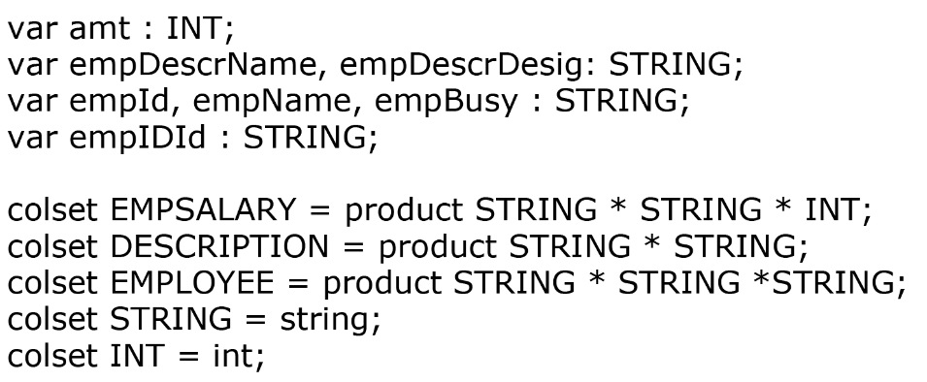
VIEW PLACE COMPUTATION

